Slide 1
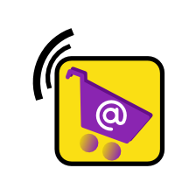

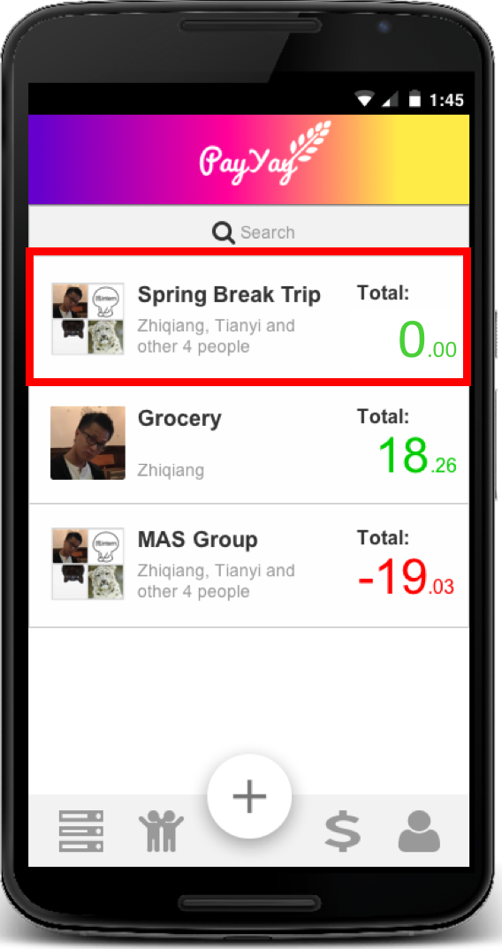
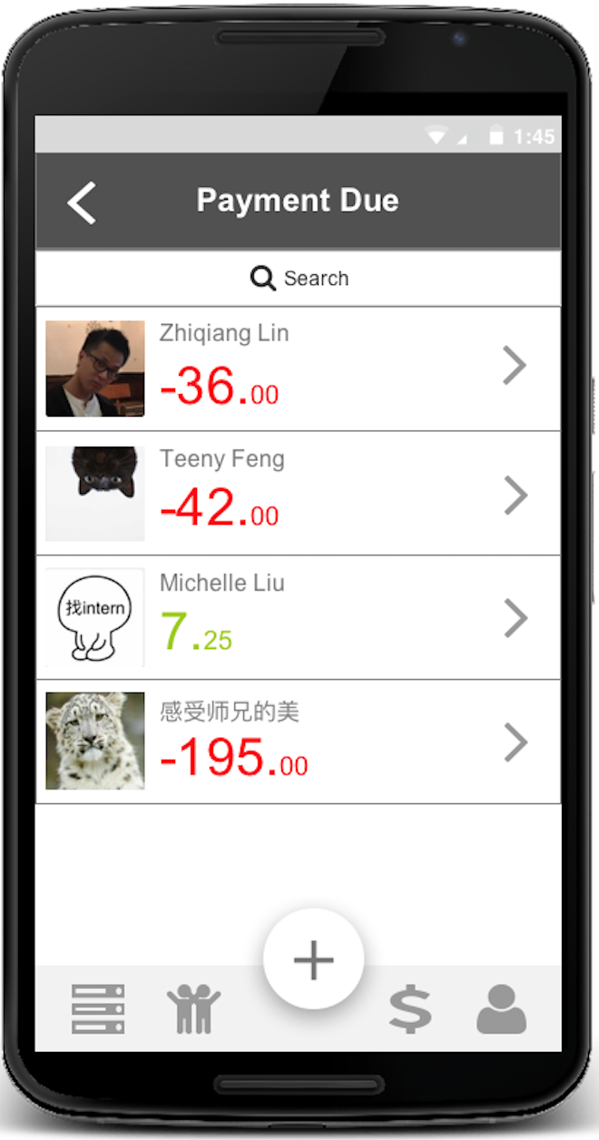
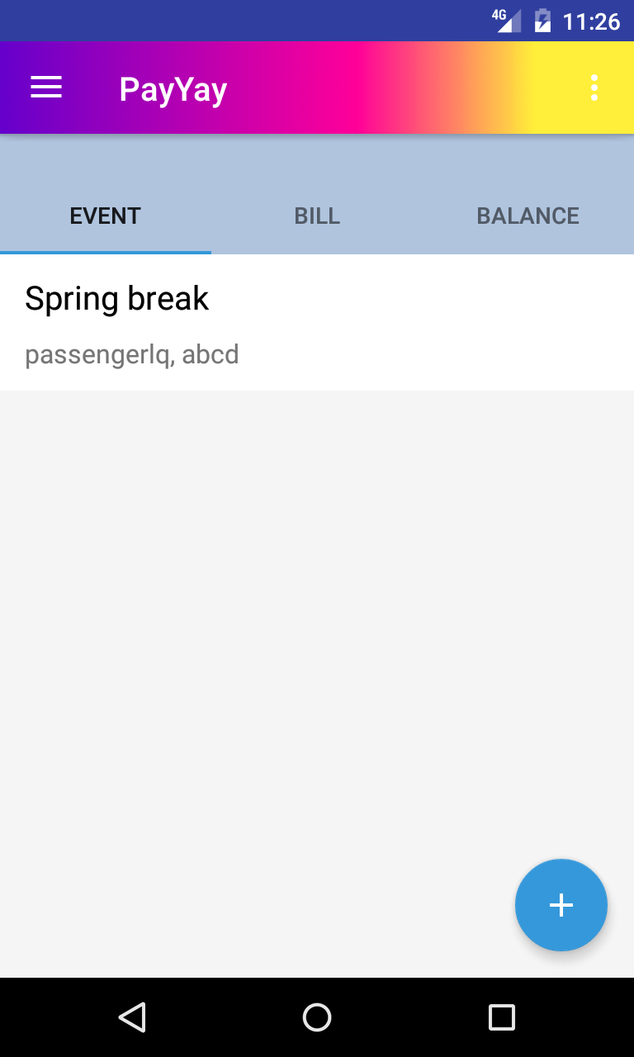
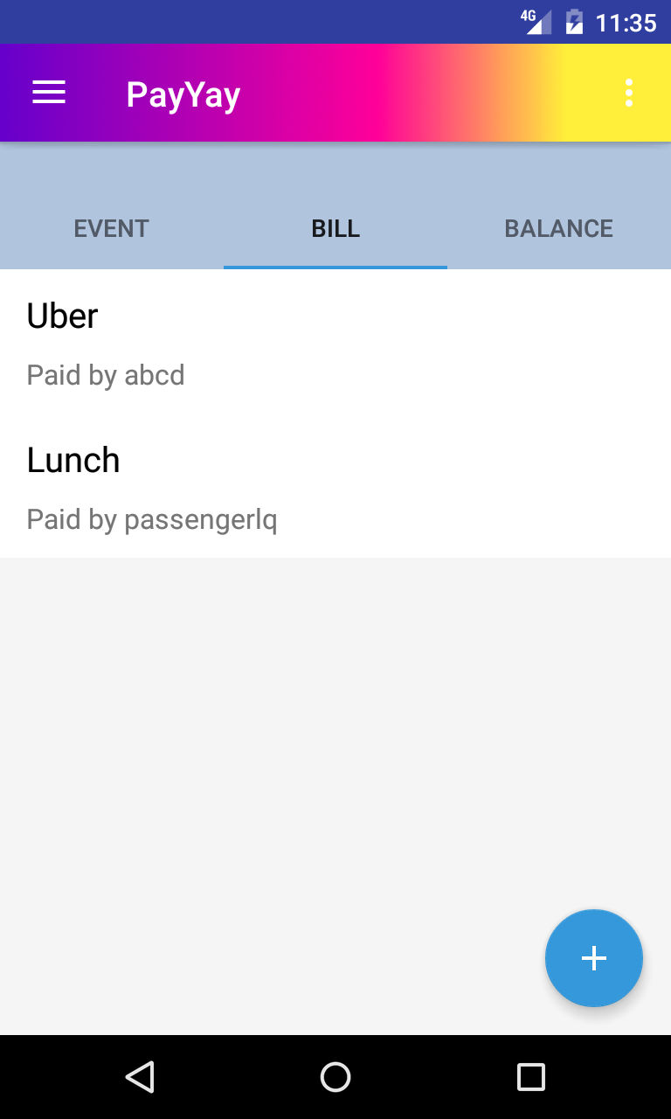
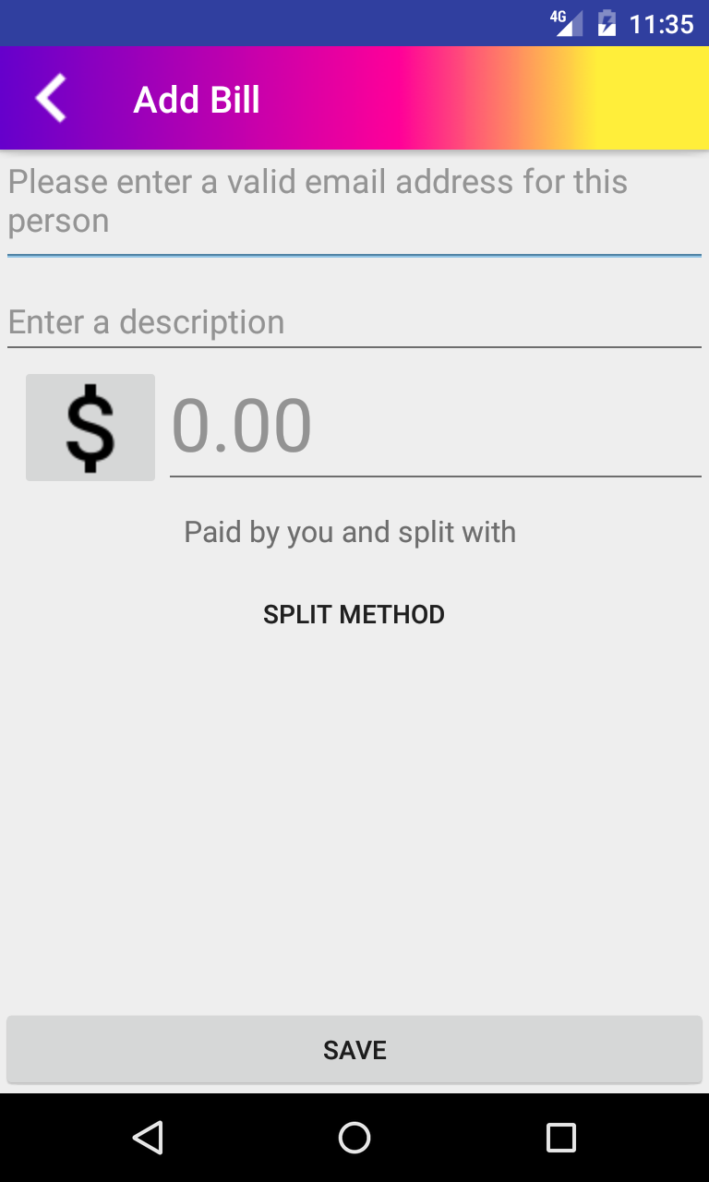
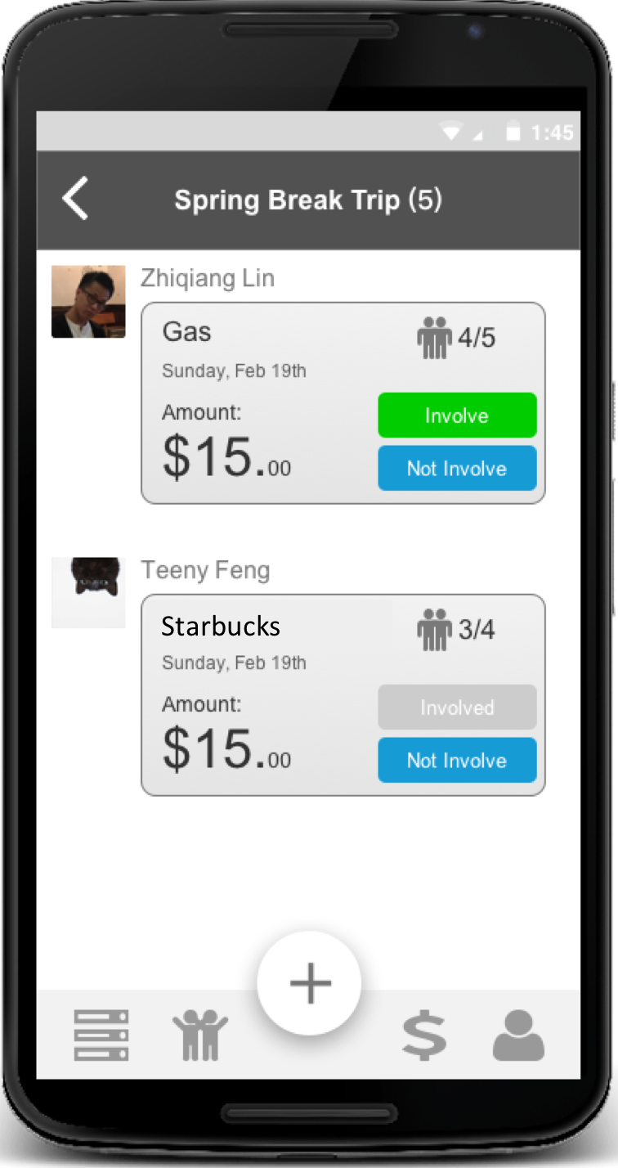
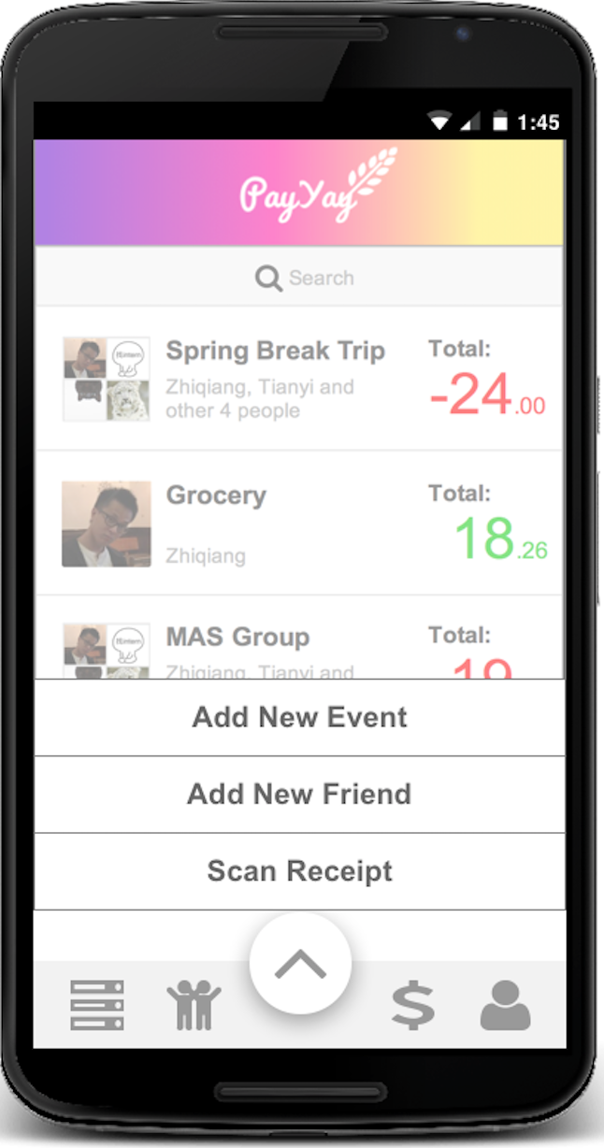
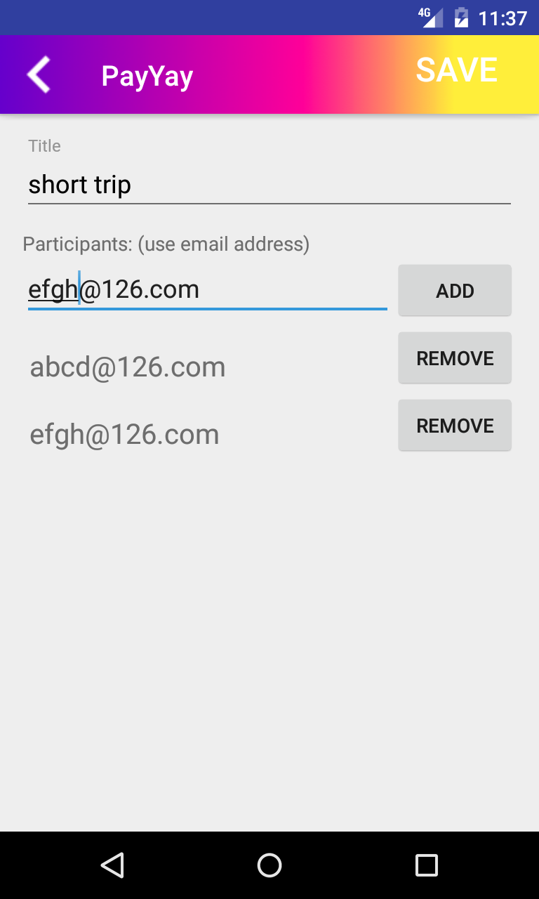
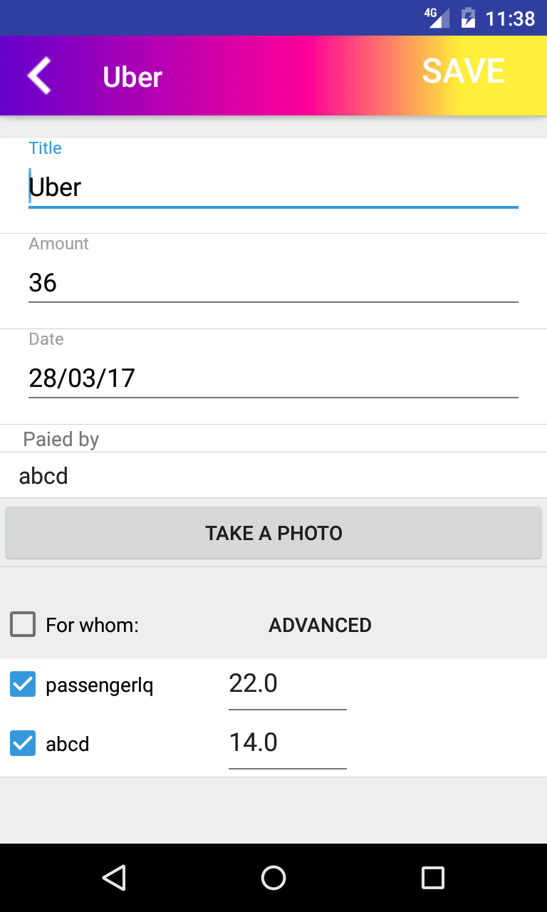
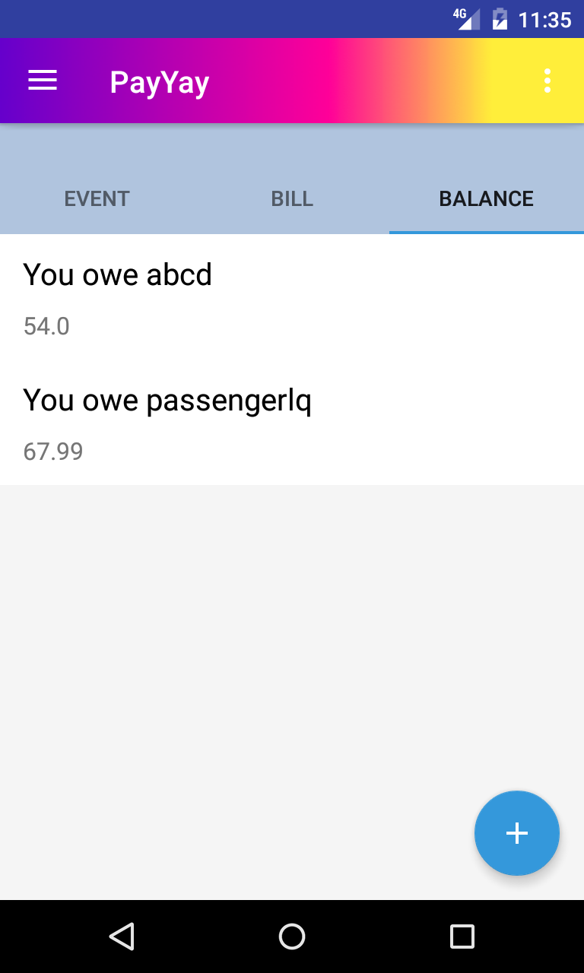


PayYay!
Motivation
Mobile Application Design & Implementation
1
3
Hang out with friends and ends up with a handful of receipts?
Design of User Flow
Demo Presentation
Hang out with friends and ends up with a handful of receipts?
Annoyed of doing math for bill-splitting?
With PayYay!:
Say goodbye to paper receipts!
– Bills and receipts management for you
Get everyone involved in group payments!
– Everyone could edit and contribute
No more mathematic work!
– Intelligent app does all the math for you
Main Features
Do It Together
User Feedbacks
4
Collect Funds for Future Events
“Can we attach photos, say like a picture of receipt, to the bill? ” -- Georges
Store Receipts by Photos
Of course! Now with each bill you can save pictures. In the future we may even analyze the content of the picture to automatically generate bill information -- Team Kiwi
Settle Debts Elegantly
“It would be nice to be able to add the date and time when the bill was originally created.” -- Tian
Intelligent and Customized Splitting
We have already added this function in the latest version! Now you can better identify bills based on date and time. -- Team Kiwi
“Please support money transaction! I want to take care of all my bills in one app.” -- Ruomeng
2
Currency Convertor
That is our ultimate goal! We hope we can achieve this some day. And you will be the first person to know this good news. -- Team Kiwi
Team Kiwi – Qian Lyu, Zhiqiang Lin, Yuan Liu, Yichuan Wang, Tianyi Feng
cic.gatech.edu
Notes:
Convenience:
Allowing users to get rid of tons of receipts and endless manual calculation among group and individual bills.
Raising funds by just clicking and editing.
Ubiquity:
Worldwide potential user community and borderless usage enabled by currency conversion.

